Slide 1
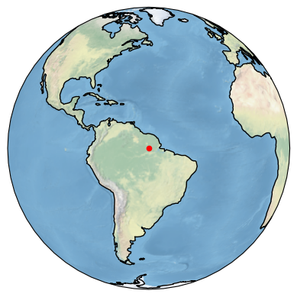



.
.
$$r$$
$$$$
$$r+s$$

Slide 2
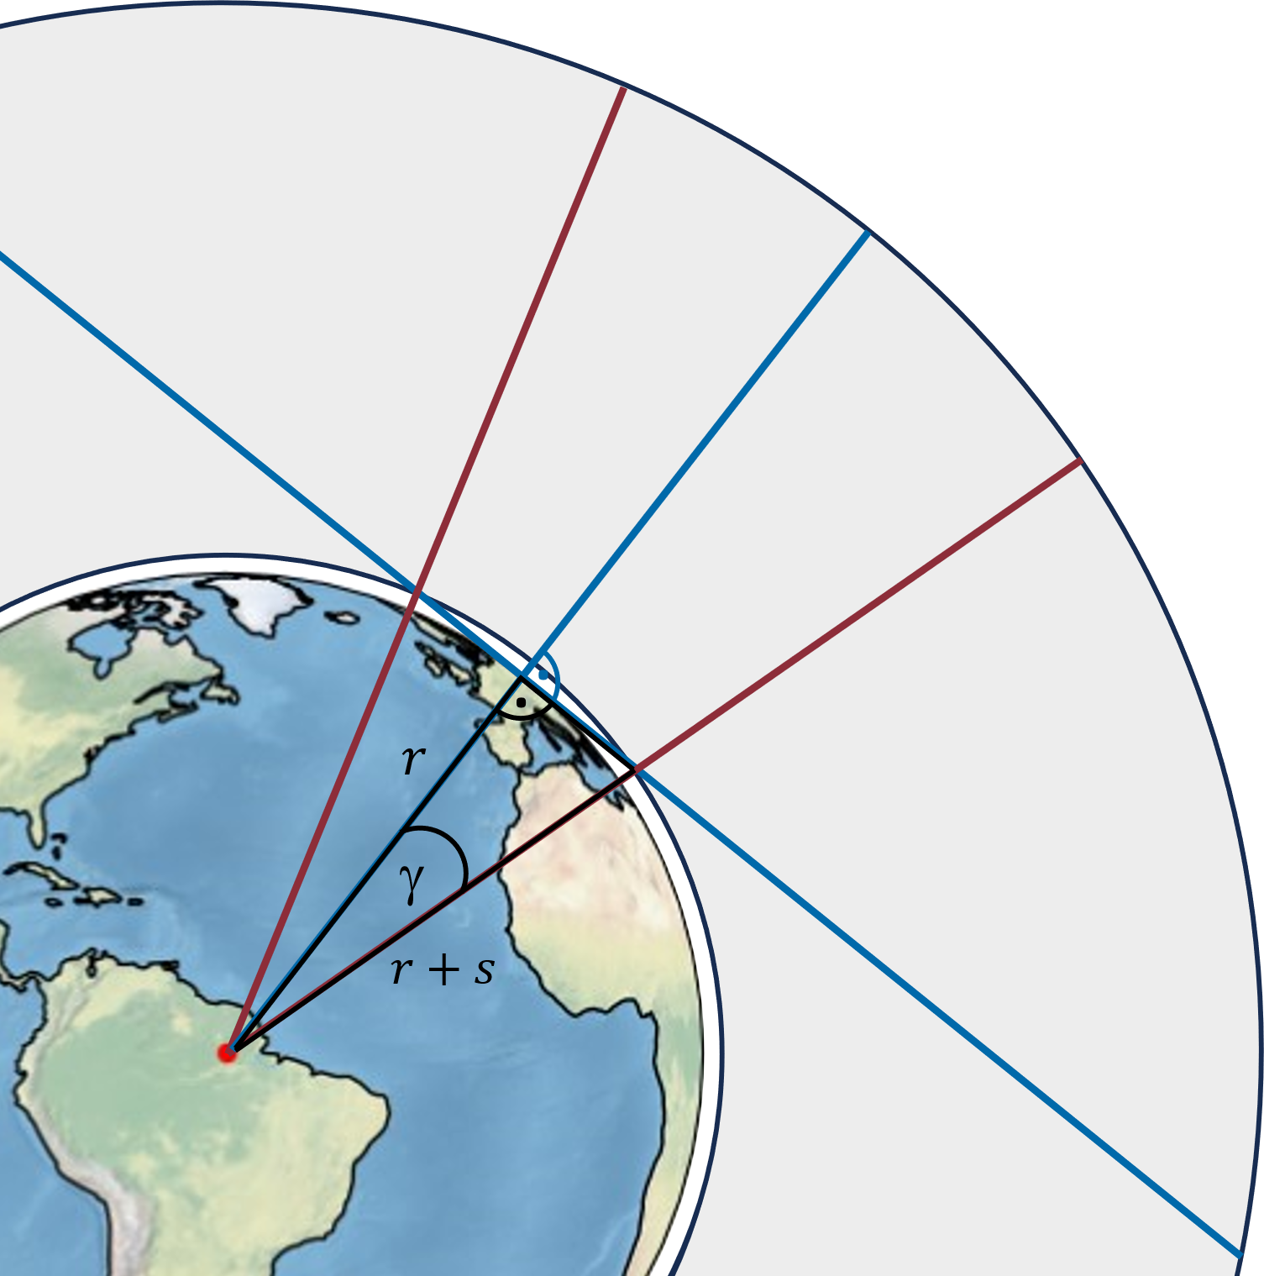

Slide 3
.
.
$$r$$
$$$$
$$r+s$$

Slide 4
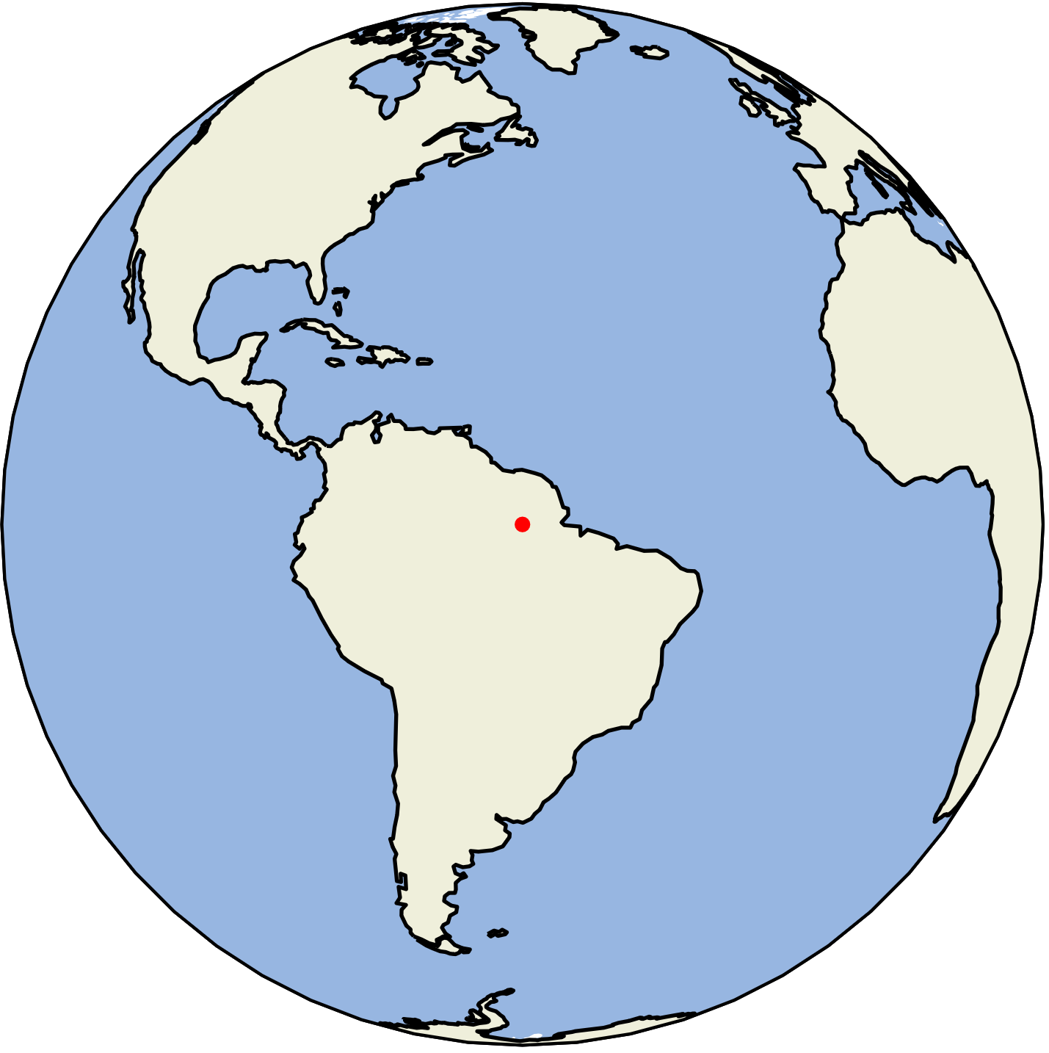
.
.
r
γ
r+s

Slide 5
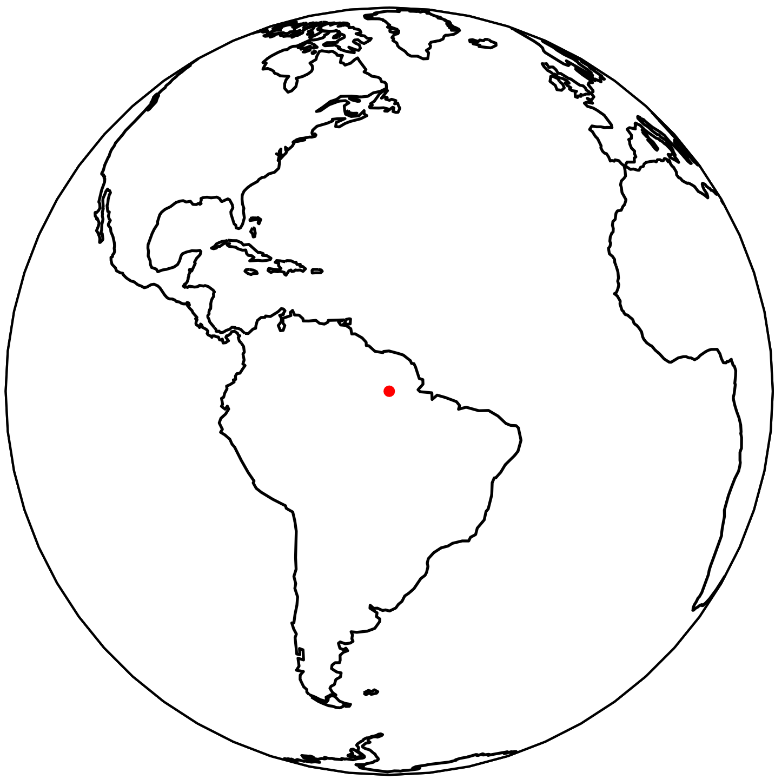
.
.
r
γ
r+s

Slide 6
